Slide 1


SOFTWARE GROUP PROJECT: JOB PORTAL WEBSITE
GUIDED BY : PREPARED BY :
Prof. SAGAR PATEL ROHIT RAVARIYA (18CE100)
Prof. DHAVAL BHOI SHIVAM SHAH (18CE116)
VAIBHAV RAJ SRIVASTAVA (18CE125)
PRUTHVIRAJ VAGHELA (18CE133)

Slide 2

CONTENTS
DEFINITION
DESCRIPTION
OBJECTIVE
MOTIVATION
HARDWARE & SOFTWARE REQUIREMENT
FLOWCHART
FRONTEND / BACKEND
FEATURES
REFERENCES

Slide 3
DEFINITION
Job portal website is web based application which brings job recruiters to job seeker and vice versa.

Slide 4
DESCRIPTION
Job portal is developed for creating an interactive job vacancy Portal for candidates.
It enables jobseekers to post their resume, search for jobs, view personal job listings.
It provides various companies to place their vacancy profile on the site and also have an option to search candidate resumes.

Slide 5
OBJECTIVE
The objective of the Job Portal is to enable jobseekers to place their resumes and find appropriate jobs while companies to publish their vacancies and find good candidates for the suitable job.

Slide 6
MOTIVATION
In real-time interaction of recruiters with the candidate becomes more time-consuming. So, to reduce the wastage of time, companies need to act fast with the new advancement for candidate hiring in the market. Creating a job portal would work to consume less time.

Slide 7

HARDWARE AND SOFTWARE REQUIREMENTS
HARDWARE
Processor : Pentium IV or Above
1GB RAM and higher
SOFTWARE
Sublime text/VS Code
Xampp/Wampp Server
Web Browser

Slide 8
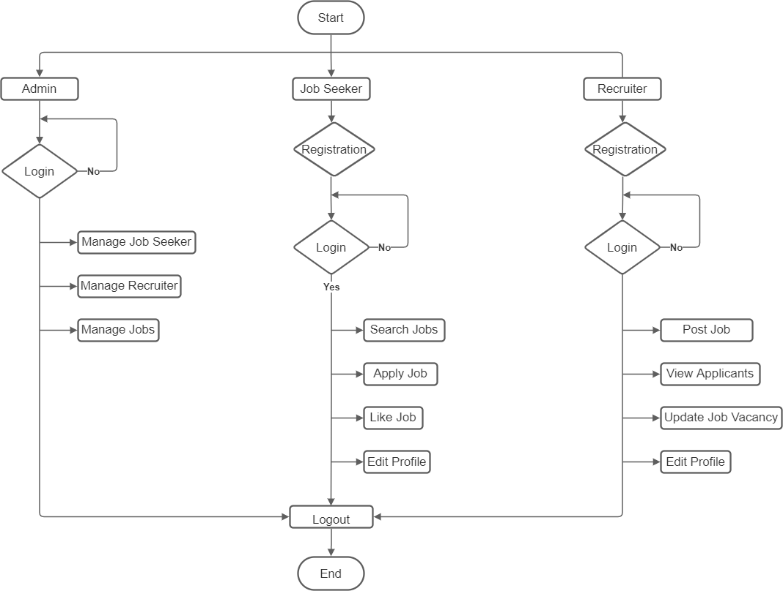
FLOWCHART

Slide 9






FRONT END / BACK END
HTML
CSS
BOOTSTRAP
JAVASCRIPT
PHP
MySQL

Slide 10
FEATURES
Search jobs on the basis of skills, city, job title
Apply for job by submitting resume for Jobseeker
About Us
Contact Us
Recent Jobs

Slide 11
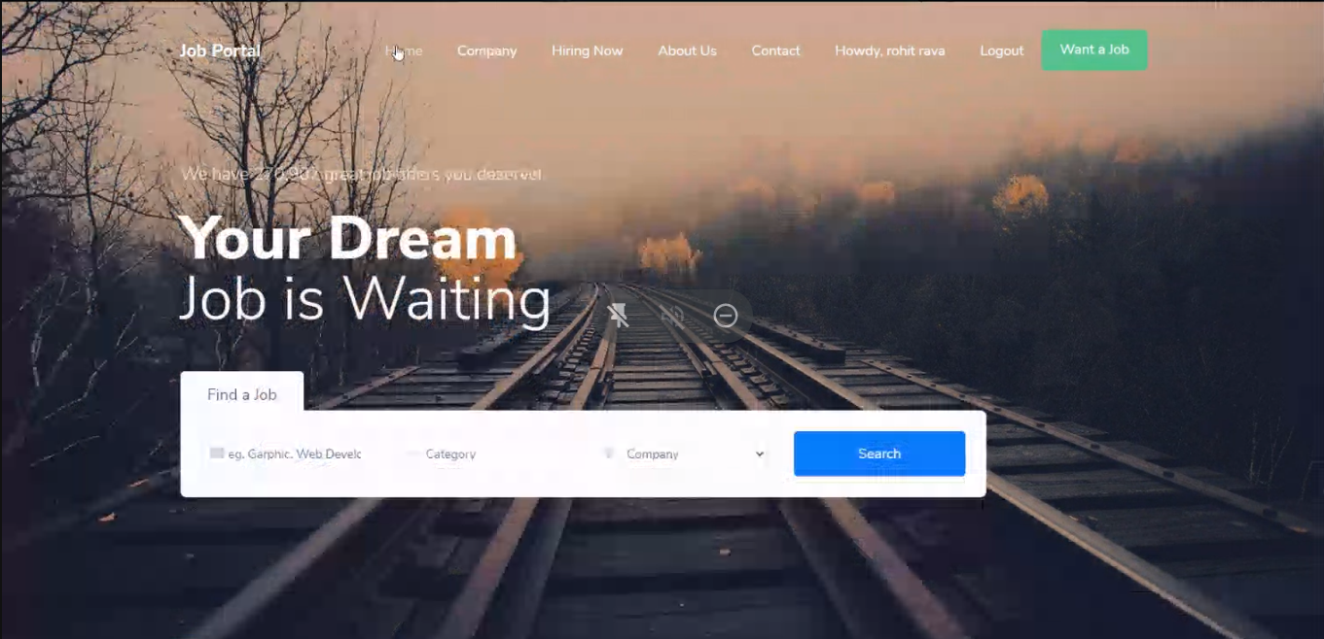
SCREEN SHOTS

Slide 12
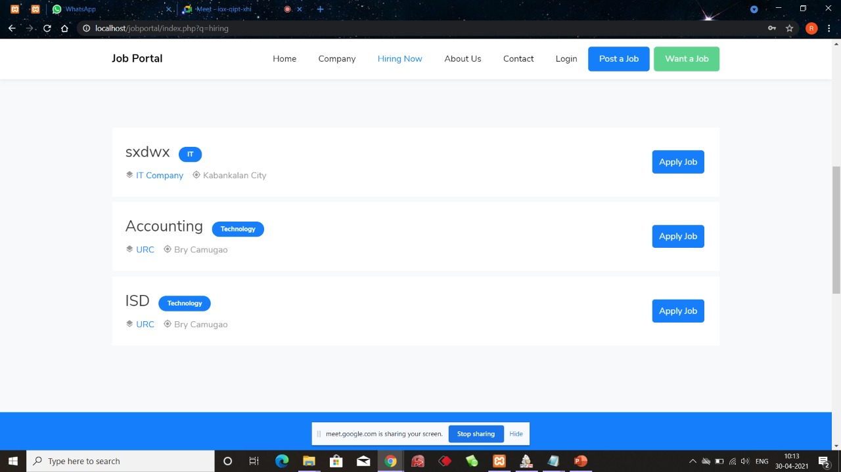
SCREEN SHOT

Slide 13
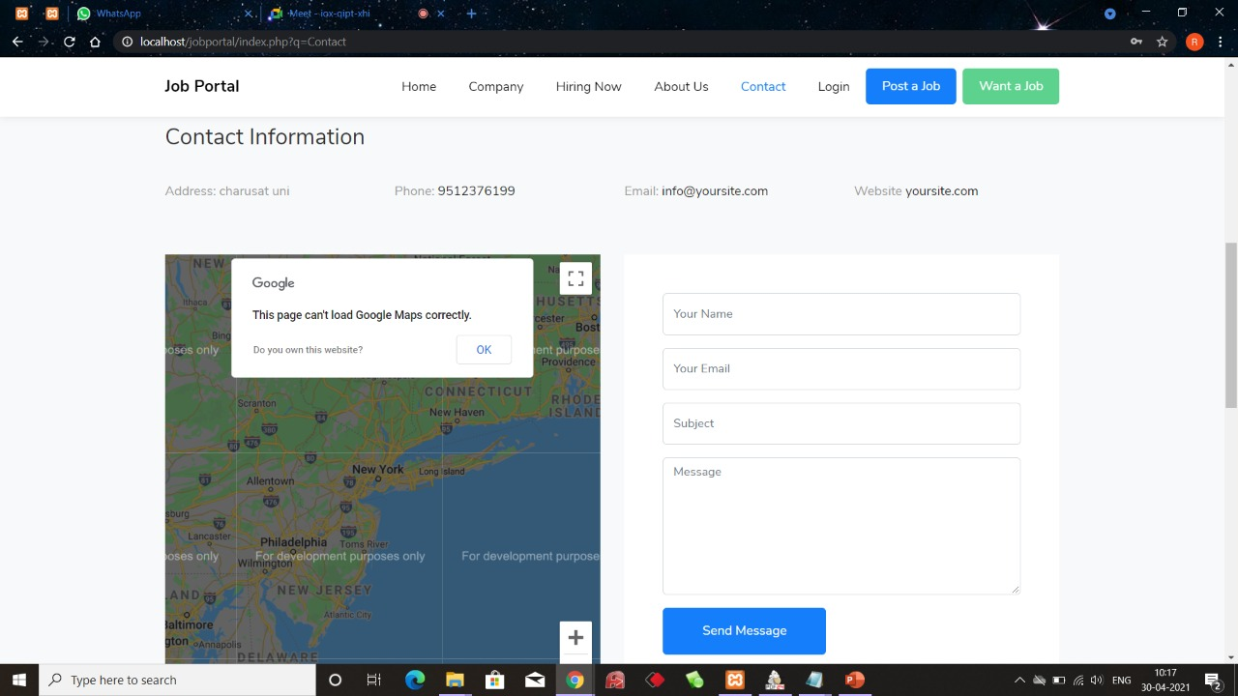
SCREEN SHOT

Slide 14
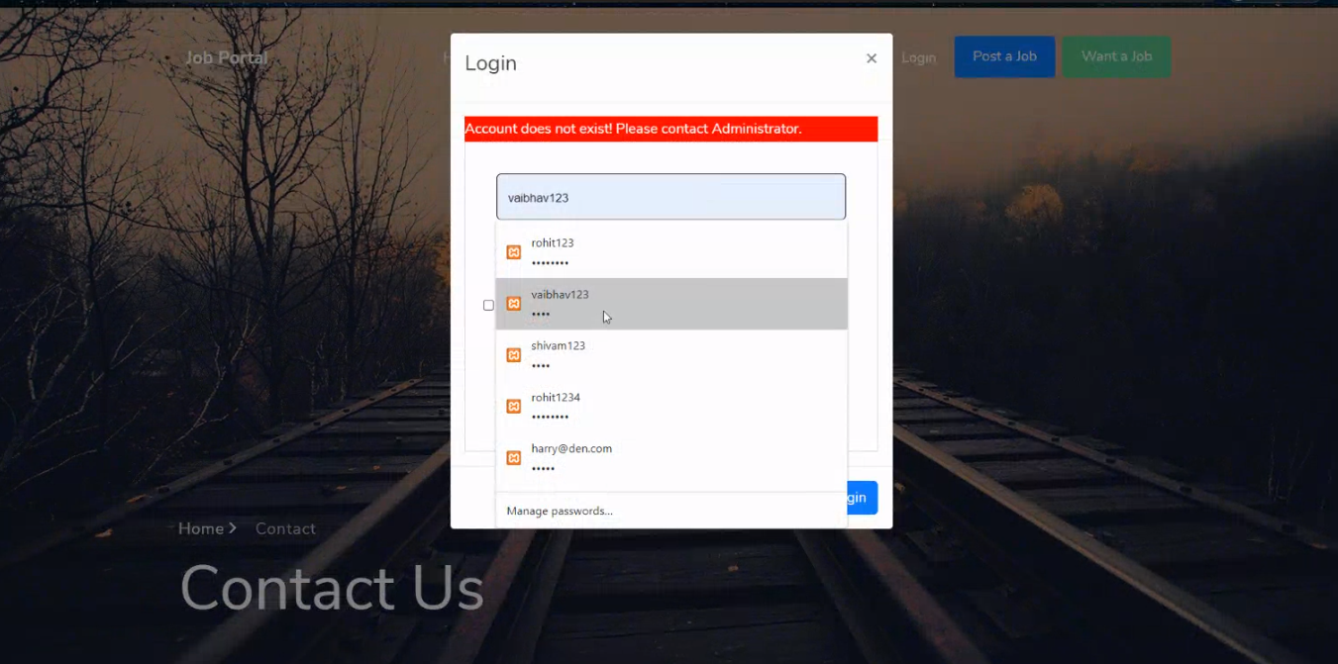
SCREEN SHOT

Slide 15
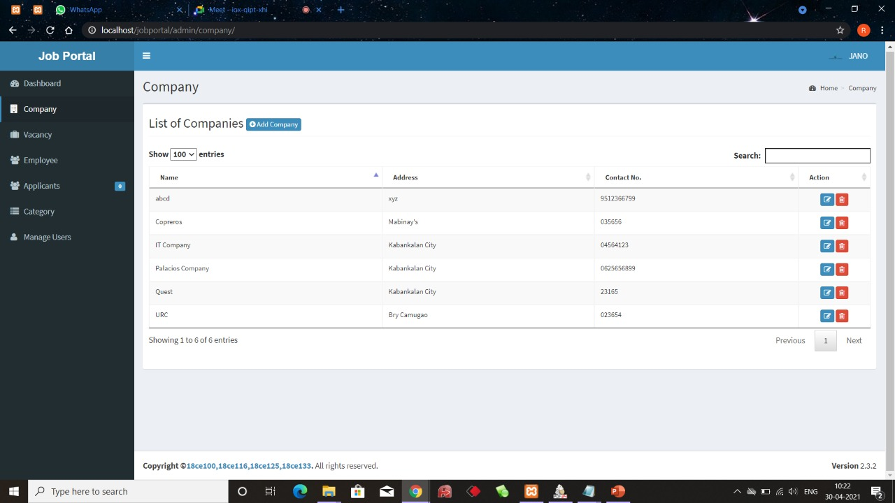
SCREEN SHOT

Slide 16
REFERENCES
https://www.signitysolutions.com/blog/steps-to-create-job-portal-website/
https://www.w3schools.com/php/
https://www.youtube.com/watch?v=gHE9lCxid0k&t=5s

Slide 17


